Slide 1
Customer Revenue Grid

Slide 2



Project Overview
A Bank is on a massive digital transformation for increasing its revenue as well as customer base. The Bank has a wide customer base where the classes are bifurcated as:-
High Revenue (1)
Low Revenue (2)

Slide 3
Project Overview
The Bank wants to run a campaign that offers the high revenue customers some attractive deals on these new digital platforms
By earning new customers through the existing customer base whose family members may have accounts in other banks. Offering them attractive offers and deals for different products.

Slide 4
Data Cleaning

Slide 5
Imputation
Some features are imputed using Mode where the missing values are less than 5%
Some features are imputed on basis of logic like:
Occupation of a person age above than 65, have a higher chance of being “Retired”
Some features are imputed with another dataset like: post_area
All the left features, the “Unknown” value is treated like a missing value itself

Slide 6
Encoding
Nominal Encoding
When a feature does not show any order or when the subcategories are less we use Nominal Encoding aka One Hot Encoding
Color
Red
Blue
Yellow
Color_Red | Color_Blue | Color_Yellow
1 | 0 | 0
0 | 1 | 0
0 | 0 | 1

Slide 7
Encoding
Nominal Encoding
When a feature does not show any order or when the subcategories are less we use Nominal Encoding aka One Hot Encoding
When drop_first = True
Color
Red
Blue
Yellow
Color_Red | Color_Blue
1 | 0
0 | 1
0 | 0

Slide 8
Encoding
Nominal Encoding
When a feature does not show any order or when the subcategories are less we use Nominal Encoding aka One Hot Encoding
Nominal Encoded Features:-
Gender
Children
Self Employed
Self Employed Partner

Slide 9
Encoding
Ordinal Encoding
When a feature shows a form of order or has a good frequency distribution, we can assign a rank to it
Ordinal Encoded Features:-
Family Income
Occupation
Occupation_partner

Slide 10
Encoding
Mean Encoding
When we rank or assign a probability value according to the distribution of its feature with respect to one of the subcategories with respect to dependent column
Mean Encoded Features:-
Region
Post_Code
Post_Area
Age_band
TV_Area

Slide 11
Transformation
Makes record comparable within itself in a feature

Slide 12
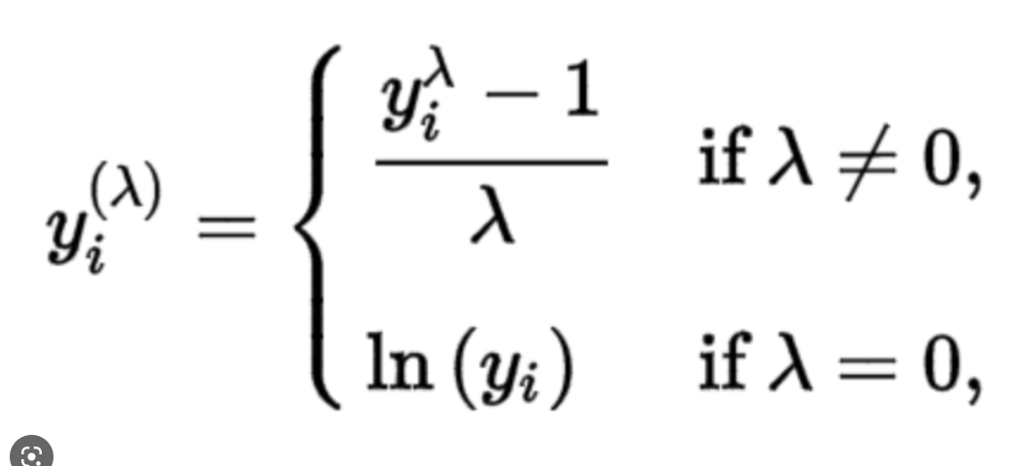
Transformation
Benefits of Transformation
Handles Outliers
Better Model Performance
Tries to maintain Normal Distribution.
Transformation Used:-
Box Cox,

Slide 13
Scaling
When you scale different features to make them comparable to each other

Slide 14
Feature Selection

Slide 15
Feature Selection
When you select features on the basis of decrease in node impurity, weighted by the probability of reaching that node

Slide 16
Feature Construction
Introducing new parameters in dataset to increase model performance,
and find indirect relationship of features
Features Introduced:-
Total Debt (Personal_loan + Home_Loan + Avg_Credit_Card_balance + Balance to transfer)
Total Investment (Term Deposit + Equity + Debentures + Tax Rate Bonds )
Total Investment / Total Debt ratio

Slide 17
Feature Construction
Introducing new parameters in dataset to increase model performance,
and find indirect relationship of features
Selected Features :-
['family_income', 'year_last_moved', 'Average.Credit.Card.Transaction’,
'Balance.Transfer', 'Term.Deposit', 'Life.Insurance', 'Medical.Insurance’,
'Average.A.C.Balance', 'Personal.Loan', 'Investment.in.Mutual.Fund’,
'Investment.Tax.Saving.Bond', 'Home.Loan', 'Online.Purchase.Amount’,
'Investment.in.Commudity', 'Investment.in.Equity', 'Investment.in.Derivative’,
'Portfolio.Balance', 'Investment_Portfolio', 'Total_Debt', 'Investment_Debt_Ratio']

Slide 18
ANALYSIS

Slide 19
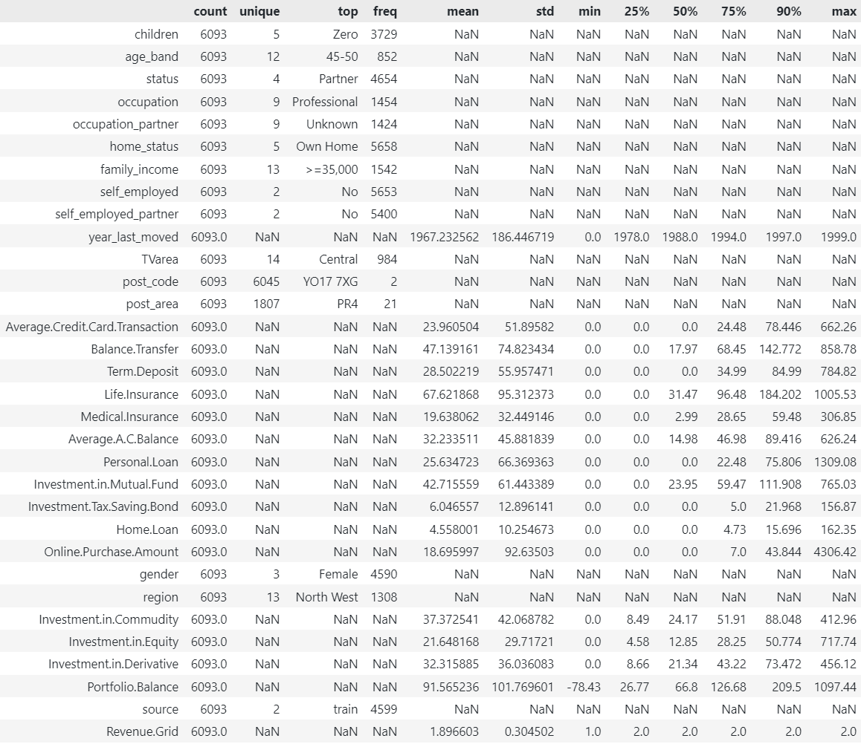
Statistical Analysis
stats_df =
Bi_Analysis.train.describe(
include="all",
percentiles=[0.25,0.5,0.75,0.9]
).T

Slide 20
High Standard Deviation

Slide 21
Upper bound Outliers

Slide 22
Most Frequent

Slide 23
Negative Value

Slide 24
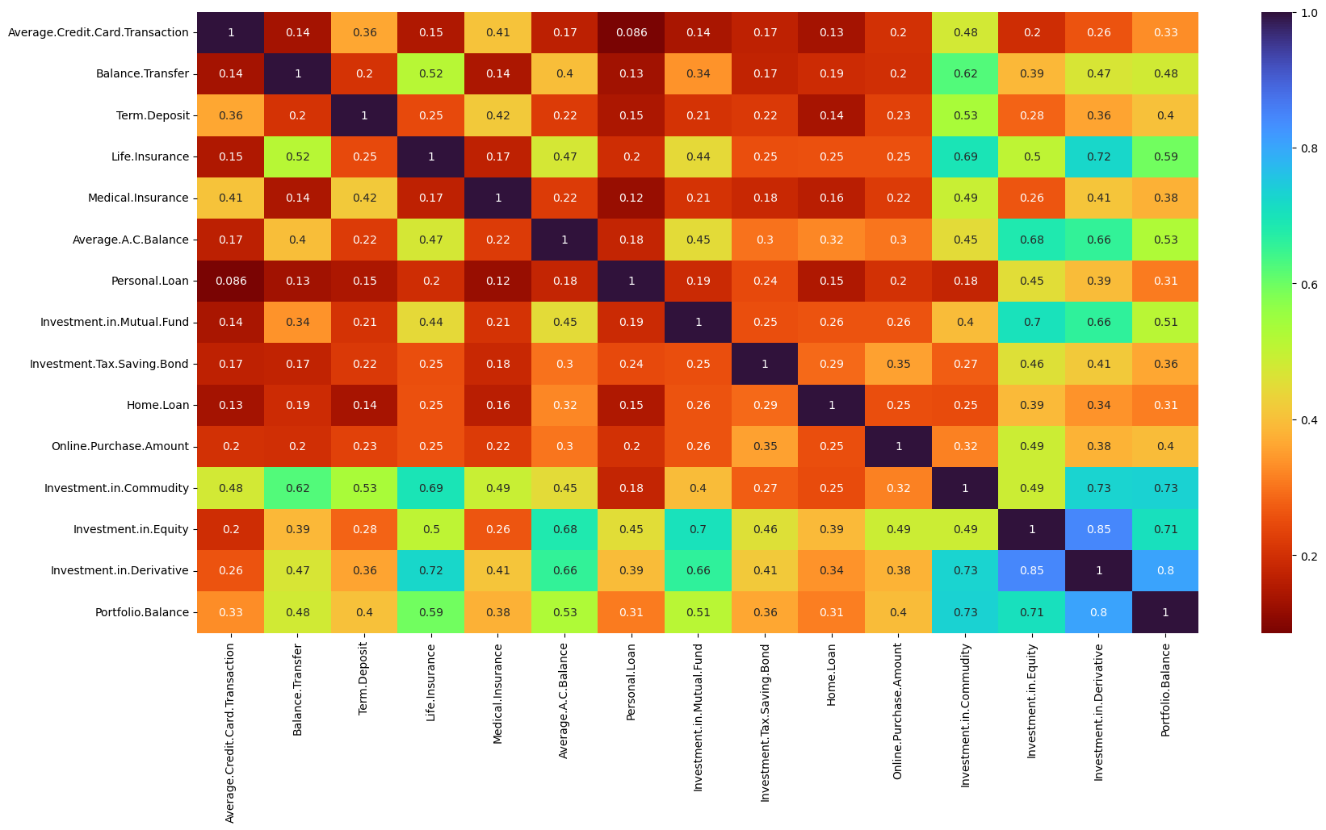
Correlation Analysis

Slide 25
Correlation Analysis
High Multicollinearity
Issue

Slide 26
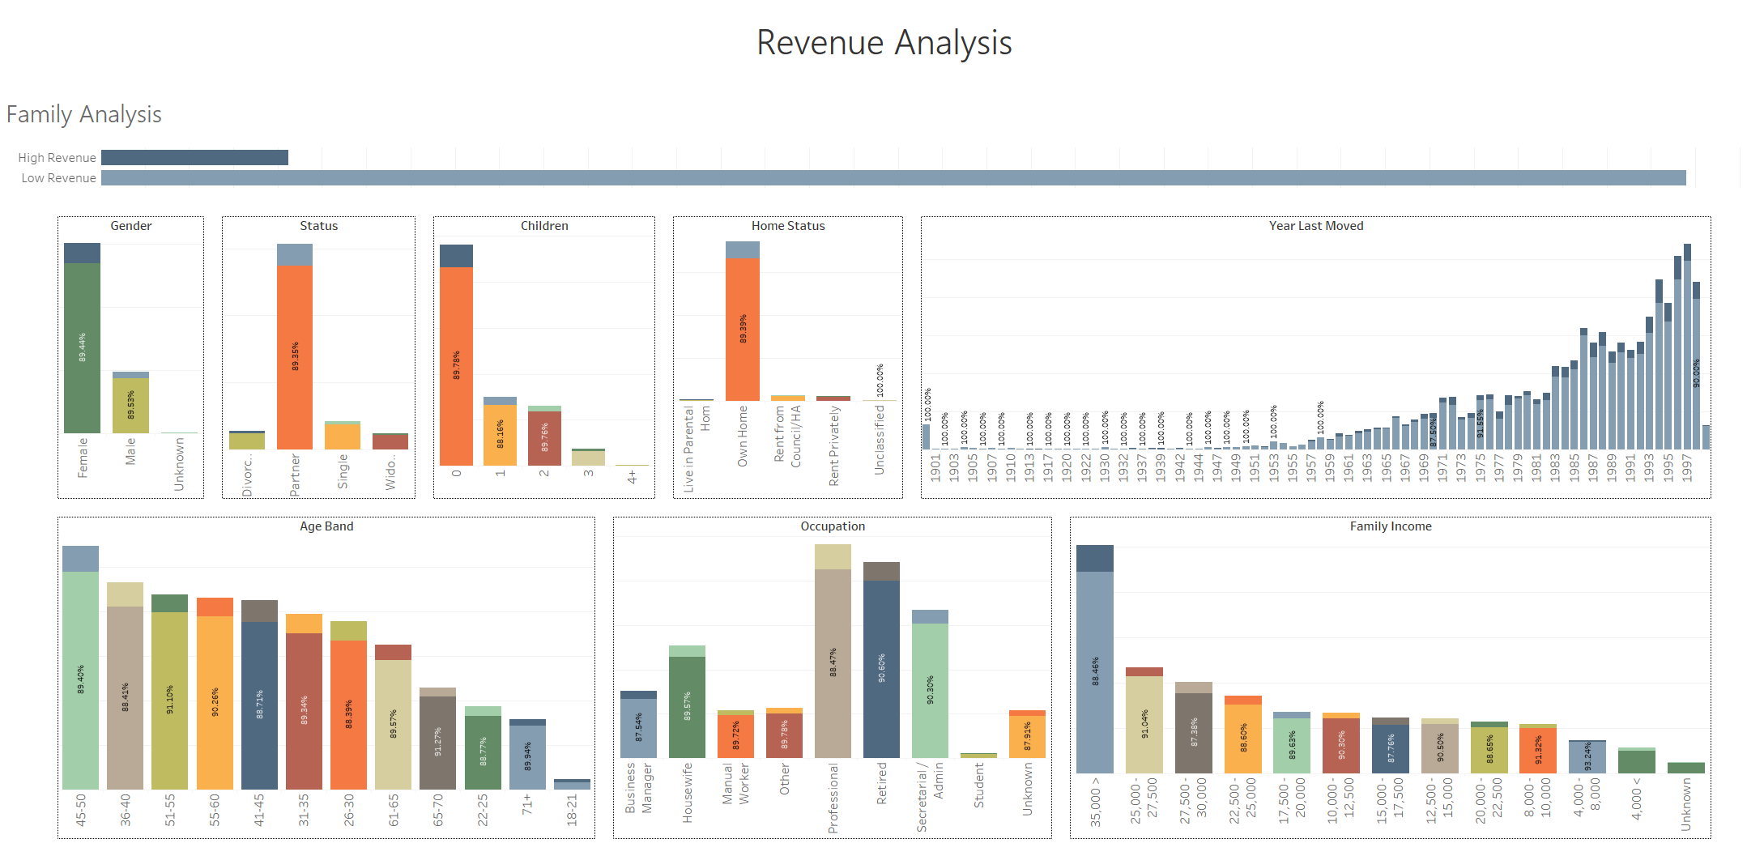
Family Analysis

Slide 27
Family Analysis
Contributes mostly under Low Revenue

Slide 28
Family Analysis
Higher Distribution of
High Revenue
Contributes mostly under Low Revenue

Slide 29
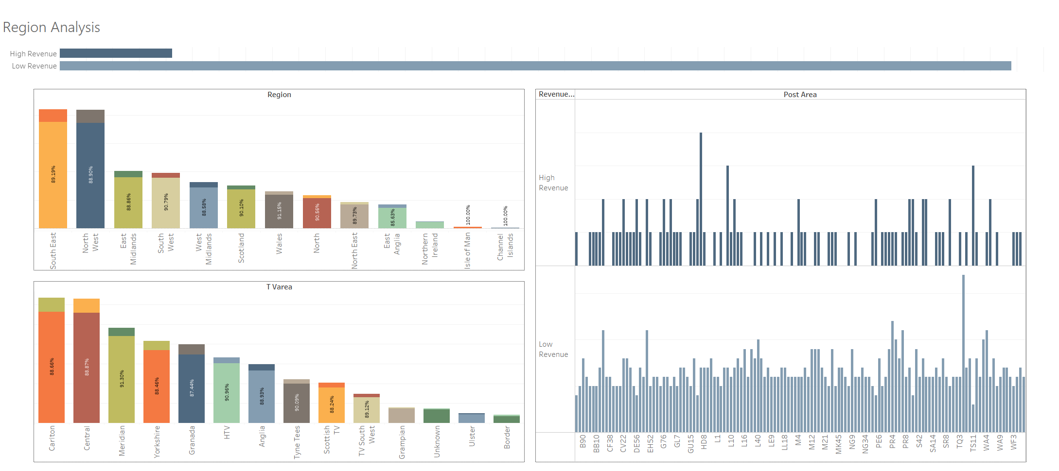
Region Analysis

Slide 30
Region Analysis

Slide 32
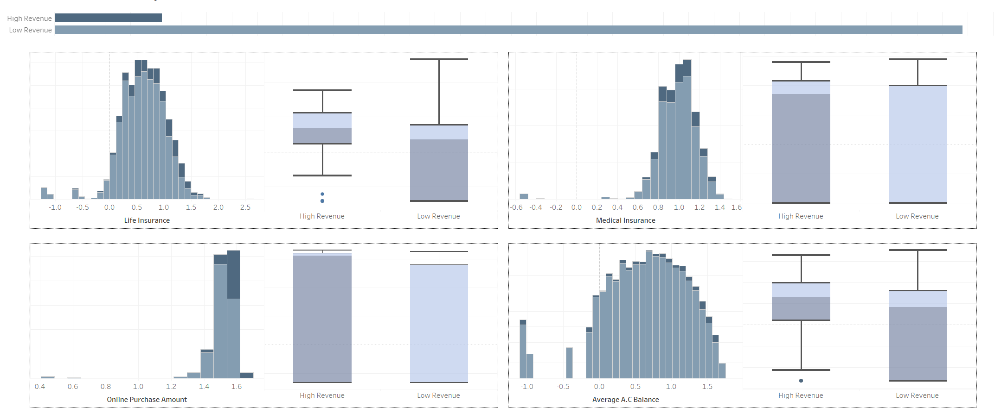
Insurance & Account Analysis

Slide 33
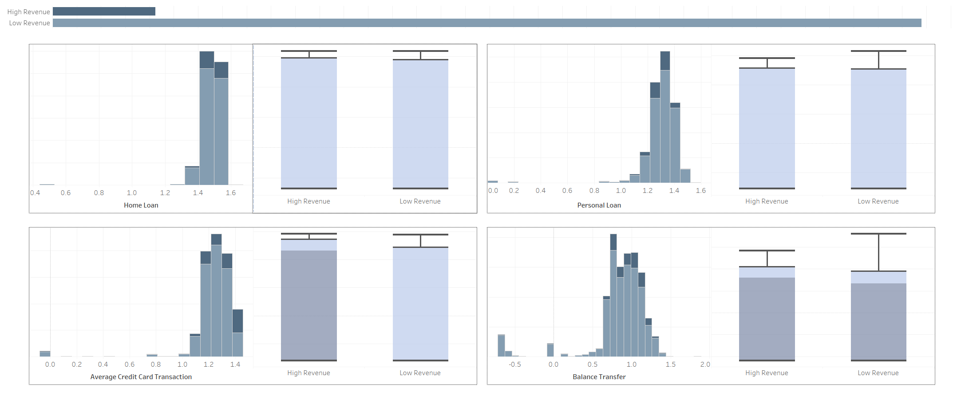
Loan Analysis

Slide 34
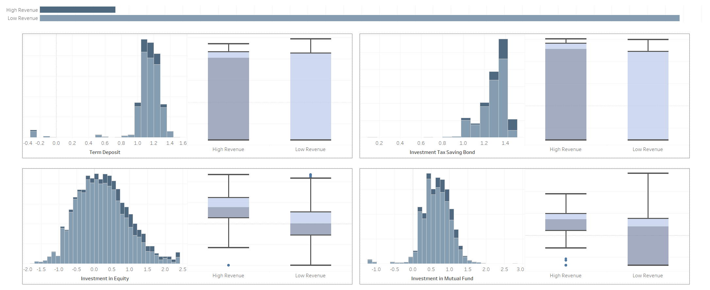
Investment Analysis

Slide 35
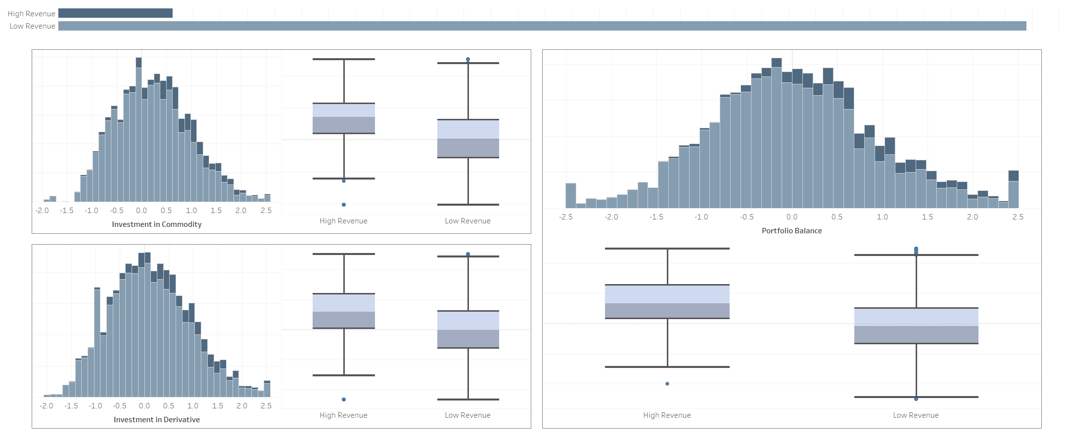
Investment Analysis

Slide 36
MODEL DEVELOPMENT

Slide 37
Logistic Regression
1
Sigmoid Function forces
all values to lie
In range 0-1
Revenue Grid
0

Slide 38
Logistic Regression
Classification Report
1
precision recall f1-score support
0.0 0.96 0.34 0.51 233
1.0 0.92 1.00 0.96 1798
accuracy 0.92 2031
macro avg 0.94 0.67 0.73 2031
Revenue Grid
0

Slide 39
Logistic Regression
Classification Report
1
precision recall f1-score support
0.0 0.96 0.34 0.51 233
1.0 0.92 1.00 0.96 1798
accuracy 0.92 2031
macro avg 0.94 0.67 0.73 2031
Revenue Grid
0

Slide 40
Logistic Regression
Classification Report
1
precision recall f1-score support
0.0 0.96 0.34 0.51 233
1.0 0.92 1.00 0.96 1798
accuracy 0.92 2031
macro avg 0.94 0.67 0.73 2031
Revenue Grid
0

Slide 41
Logistic Regression
Classification Report
1
precision recall f1-score support
0.0 0.96 0.34 0.51 233
1.0 0.92 1.00 0.96 1798
accuracy 0.92 2031
macro avg 0.94 0.67 0.73 2031
Revenue Grid
Higher False Negatives in 0 classification
0

Slide 42
Random Forest
Similar to Decision Tree

Slide 43
Random Forest
Multiple Trees drawn with
random rows & column

Slide 44
Random Forest
Decision taken on Majority voting

Slide 45
Random Forest
0
1
1
0
1
0
0
1
precision recall f1-score support
0.0 0.78 0.78 0.78 233
1.0 0.97 0.97 0.97 1798
accuracy 0.95 2031
macro avg 0.88 0.87 0.87 2031
weighted avg 0.95 0.95 0.95 2031
Classification Report

Slide 46
Random Forest
0
1
1
0
1
0
0
1
precision recall f1-score support
0.0 0.78 0.78 0.78 233
1.0 0.97 0.97 0.97 1798
accuracy 0.95 2031
macro avg 0.88 0.87 0.87 2031
weighted avg 0.95 0.95 0.95 2031
Classification Report

Slide 47
Random Forest
Higher
False Negatives
Higher
False Positives
0
1
1
0
1
0
0
1
precision recall f1-score support
0.0 0.78 0.78 0.78 233
1.0 0.97 0.97 0.97 1798
accuracy 0.95 2031
macro avg 0.88 0.87 0.87 2031
weighted avg 0.95 0.95 0.95 2031
Classification Report

Slide 48
Support Vector Machines
Data Points for Binary Classification

Slide 49
Support Vector Machines
Support Vectors are chosen

Slide 50
Support Vector Machines
Marginal Planes are drawn

Slide 51
Support Vector Machines
On the basis of Marginal Planes, a hyperplane is chosen

Slide 52
Support Vector Machines
Soft marginal Plane, Most ideal situation

Slide 53
Support Vector Machines
Hyper tuned
C
Kernel
Gamma

Slide 54
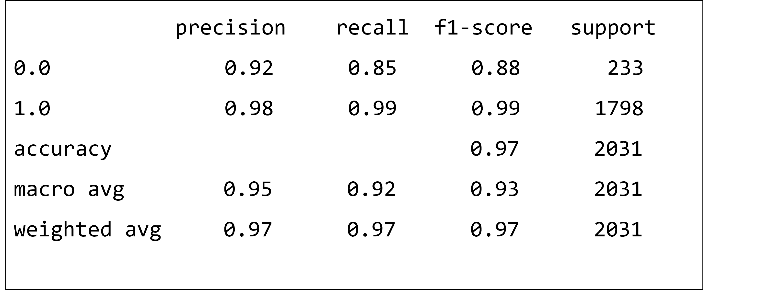
Support Vector Machines
Hyper tuned
Classification Report

Slide 55
Support Vector Machines
Hyper tuned
Classification Report
There are some False Negatives, but overall performance seems good
precision recall f1-score support
0.0 0.92 0.85 0.88 233
1.0 0.98 0.99 0.99 1798
accuracy 0.97 2031
macro avg 0.95 0.92 0.93 2031
weighted avg 0.97 0.97 0.97 2031

Slide 56
Decile Analysis

Slide 57
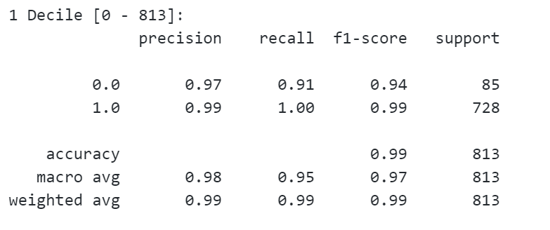
Decile Analysis

Slide 58
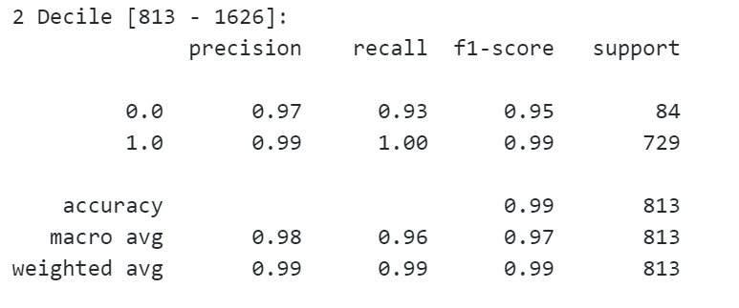
Decile Analysis

Slide 59
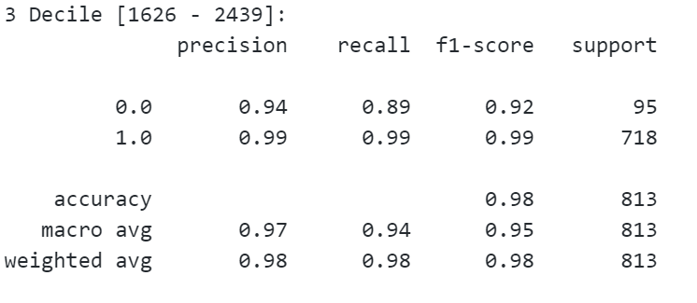
Decile Analysis

Slide 60
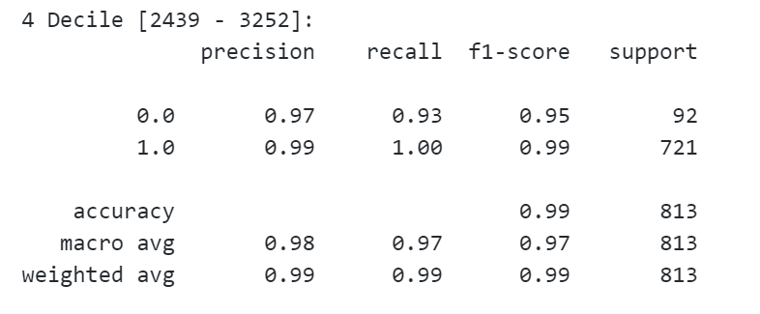
Decile Analysis

Slide 61
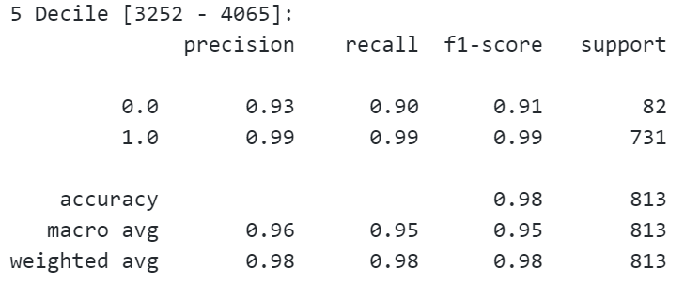
Decile Analysis

Slide 62
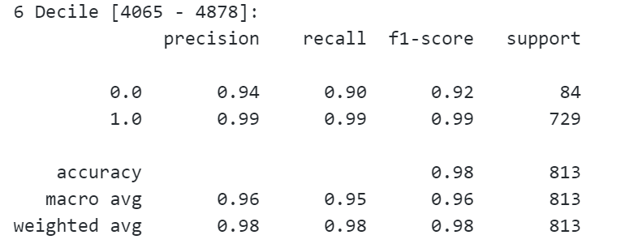
Decile Analysis

Slide 63
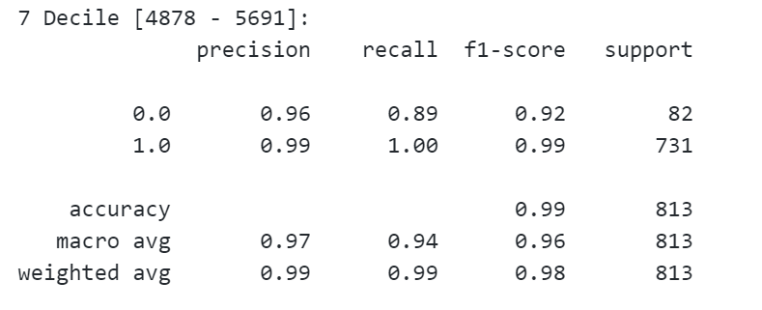
Decile Analysis

Slide 64
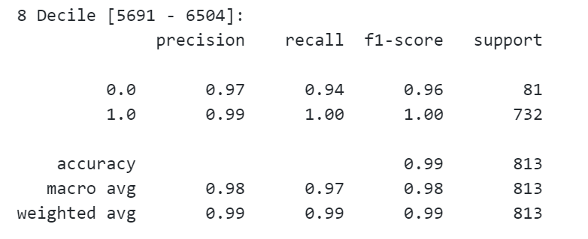
Decile Analysis

Slide 65
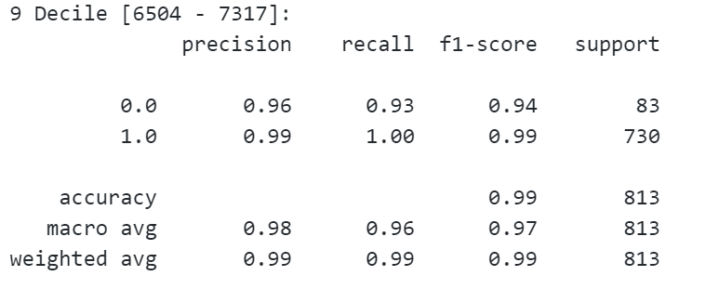
Decile Analysis

Slide 66
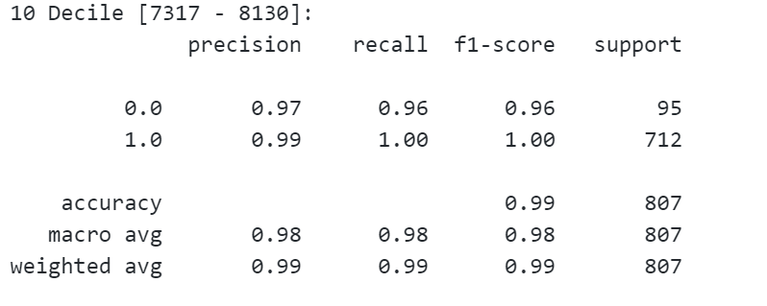
Decile Analysis

